Slide 1
GRAPH
Lab 13

Slide 2
Graph
A graph is a non-linear data structure. A graph can be defined as a collection of Nodes which are also called “vertices” and “edges” that connect two or more vertices.

Slide 3
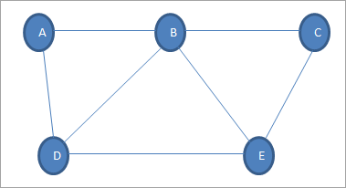
EXAMPLE
Given above is an example graph G. Graph G is a set of vertices {A,B,C,D,E} and a set of edges {(A,B),(B,C),(A,D),(D,E),(E,C),(B,E),(B,D)}.

Slide 4
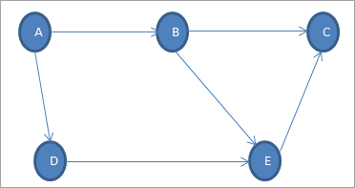
Types of Graphs
Types of Graphs – Directed And Undirected Graph
A graph in which the edges do not have directions is called the Undirected graph. The graph shown above is an undirected graph.
A graph in which the edges have directions associated with them is called a Directed graph

Slide 5
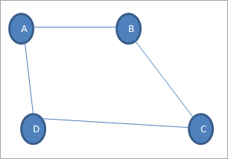
Graph Terminology
Vertex: Each node of the graph is called a vertex. In the above graph, A, B, C, and D are the vertices of the graph.
Edge: The link or path between two vertices is called an edge. It connects two or more vertices. The different edges in the above graph are AB, BC, AD, and DC.
Adjacent node: In a graph, if two nodes are connected by an edge then they are called adjacent nodes or neighbors. In the above graph, vertices A and B are connected by edge AB. Thus A and B are adjacent nodes.
Degree of the node: The number of edges that are connected to a particular node is called the degree of the node. In the above graph, node A has a degree 2.
Path: The sequence of nodes that we need to follow when we have to travel from one vertex to another in a graph is called the path. In our example graph, if we need to go from node A to C, then the path would be A->B->C

Slide 6
Graph Representation
The way in which graph data structure is stored in memory is called “representation”. The graph can be stored as a sequential representation or as a linked representation

Slide 7
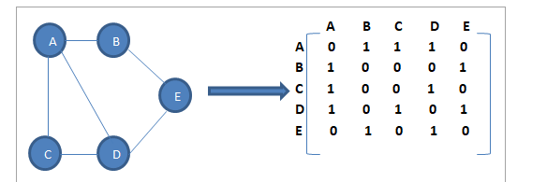
sequential representation
In the sequential representation of graphs, we use the adjacency matrix. An adjacency matrix is a matrix of size n x n where n is the number of vertices in the graph.
The rows and columns of the adjacency matrix represent the vertices in a graph. The matrix element is set to 1 when there is an edge present between the vertices. If the edge is not present then the element is set to 0.

Slide 8
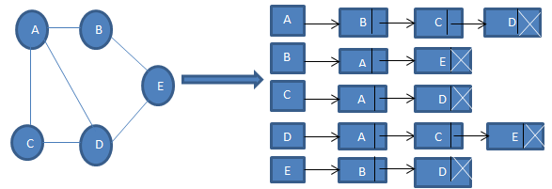
Linked Representation
We use the adjacency list for the linked representation of the graph. The adjacency list representation maintains each node of the graph and a link to the nodes that are adjacent to this node. When we traverse all the adjacent nodes, we set the next pointer to null at the end of the list.

Slide 9
real-life applications
Graphs are used to represent many real-life applications: Graphs are used to represent networks. The networks may include paths in a city or telephone network or circuit network. Graphs are also used in social networks like linkedIn, Facebook. For example, in Facebook, each person is represented with a vertex(or node). Each node is a structure and contains information like person id, name, gender and locale

